Slide 1
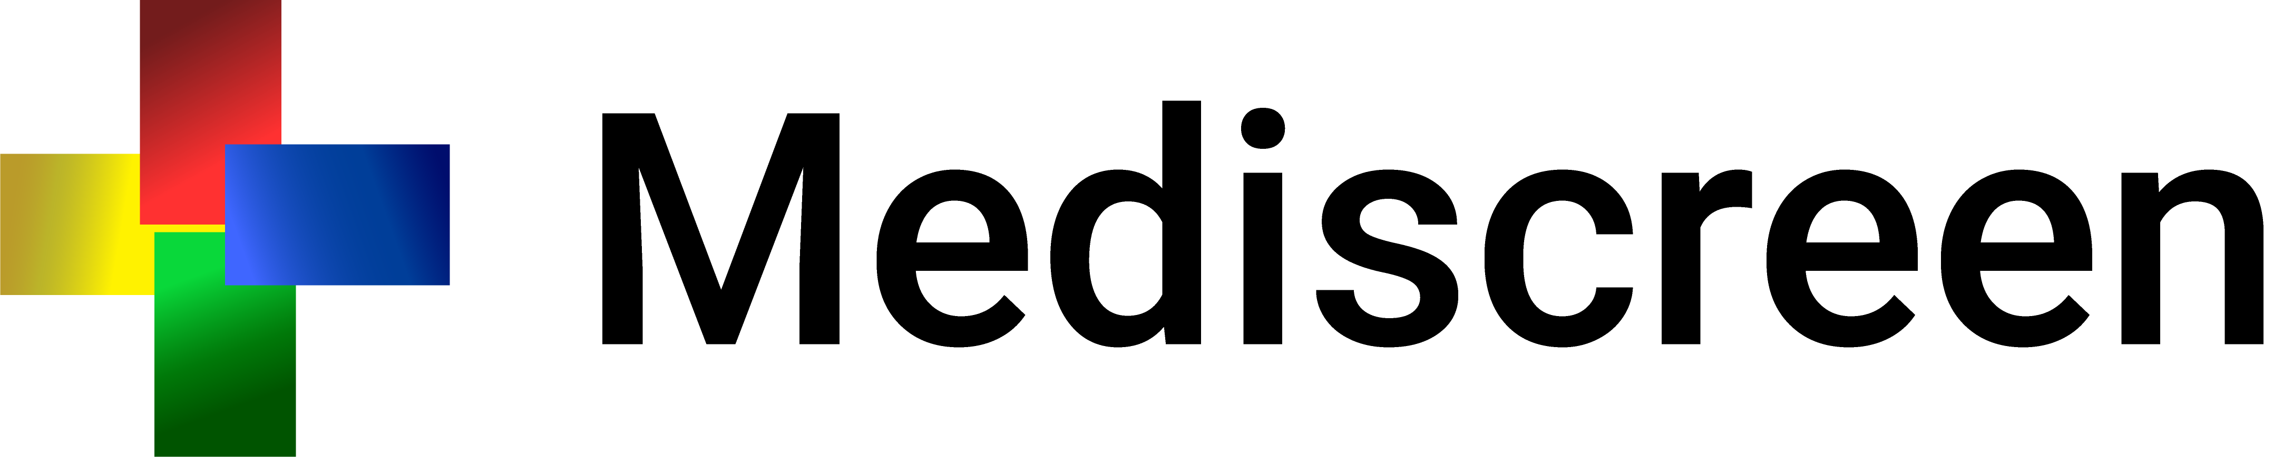

Slide 2
Summary
What is it about?
Github Repo
Technologies used
Architecture
Trello
Test coverage
Difficulties/solutions

Slide 3
What is it about?
Mediscreen application is specialized in detecting risk factors for a disease.
Application allows to detect a level of risk of diabetes in a patient, based on his age, his sex and the different notes left by the doctor.

Slide 4
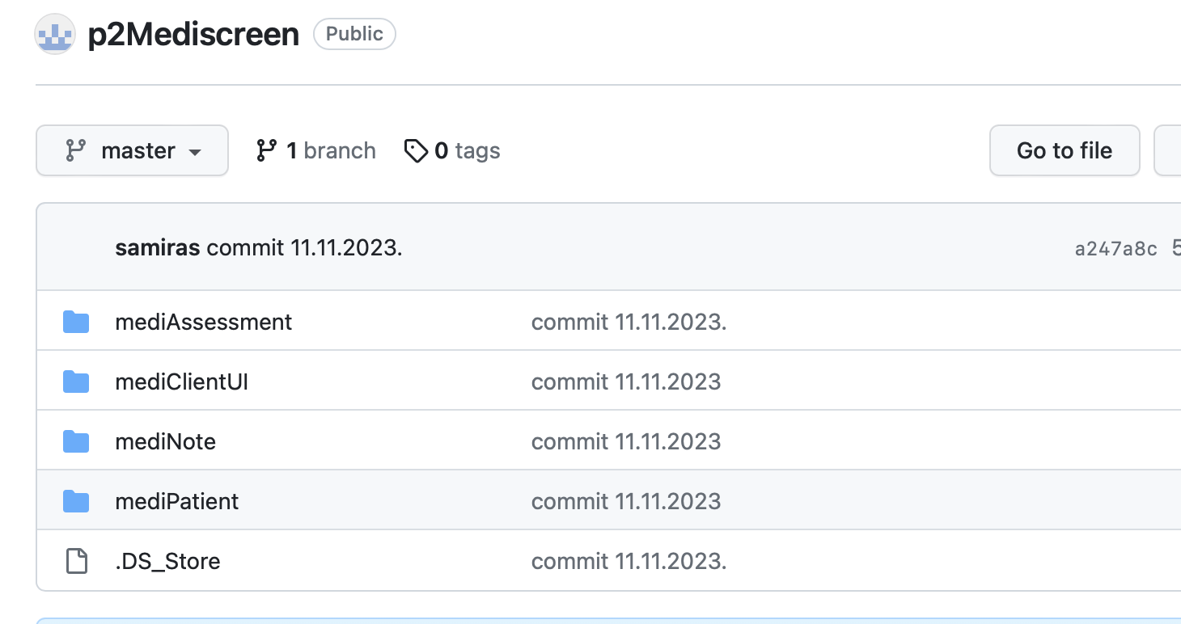
Github
Link: https://github.com/samsh06/p2Mediscreen.git

Slide 5

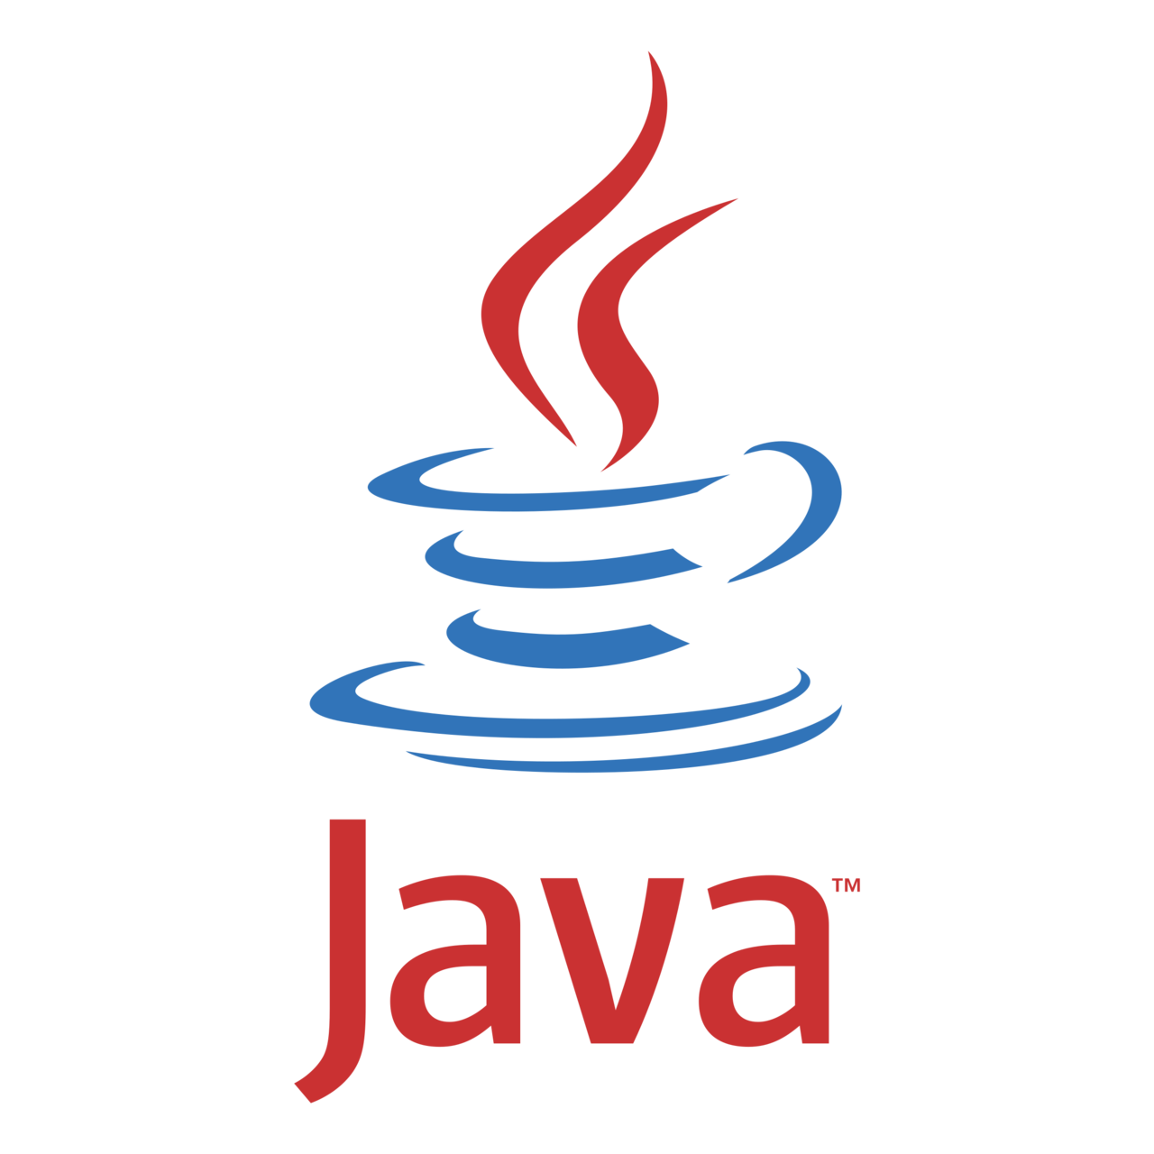
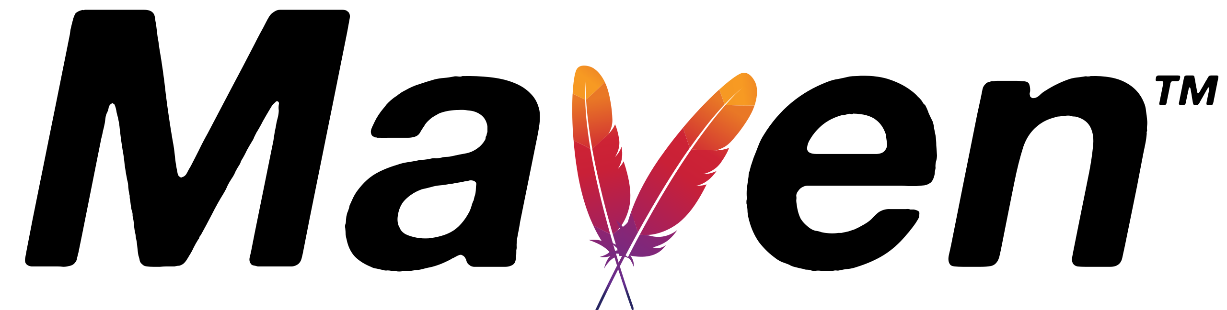
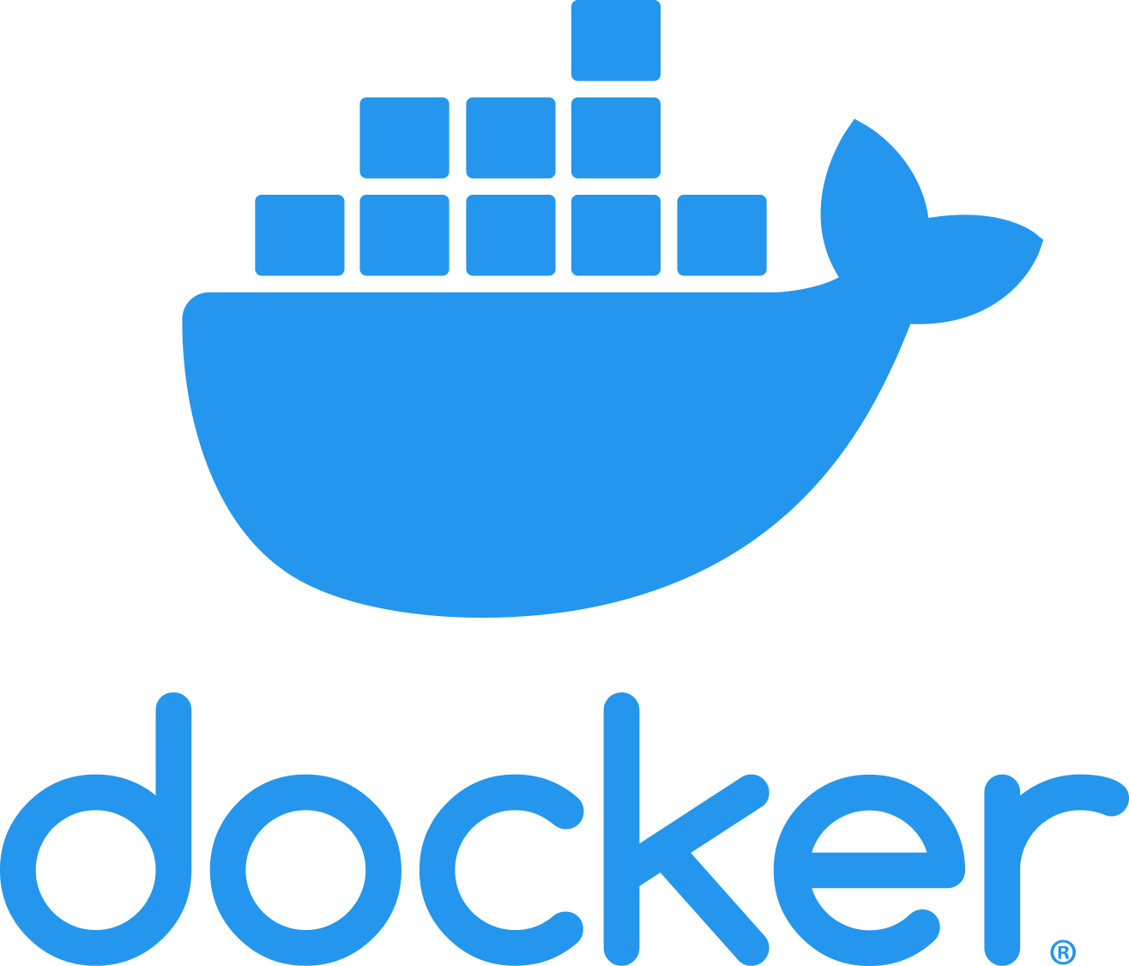
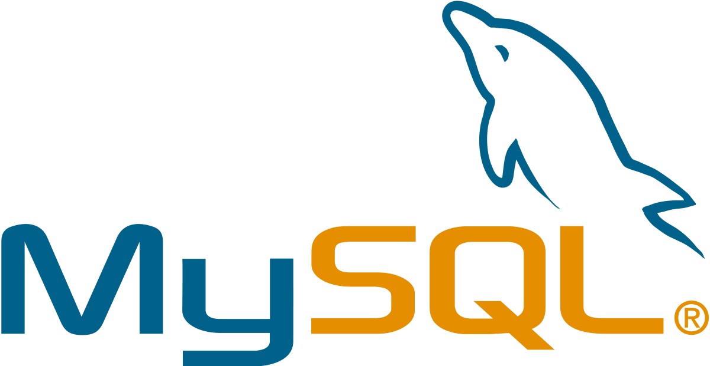


Technologies used

Slide 6
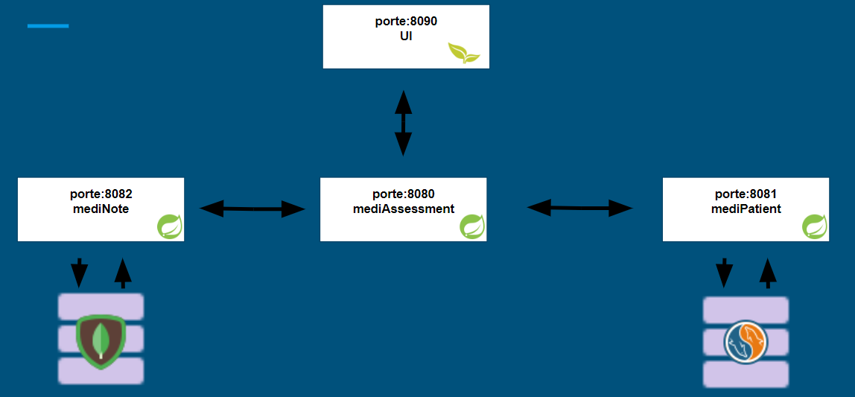
Microservice Architecture

Slide 7
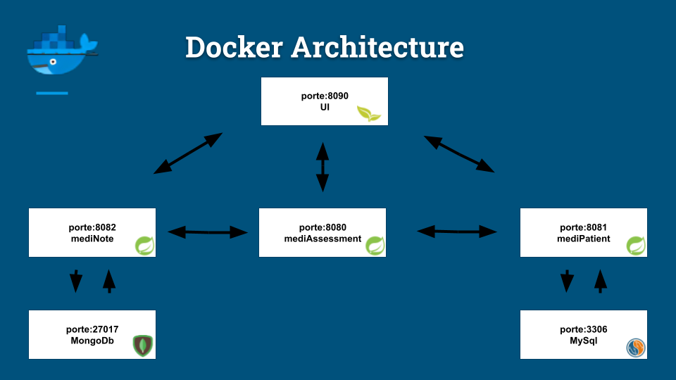
Docker Architecture

Slide 8
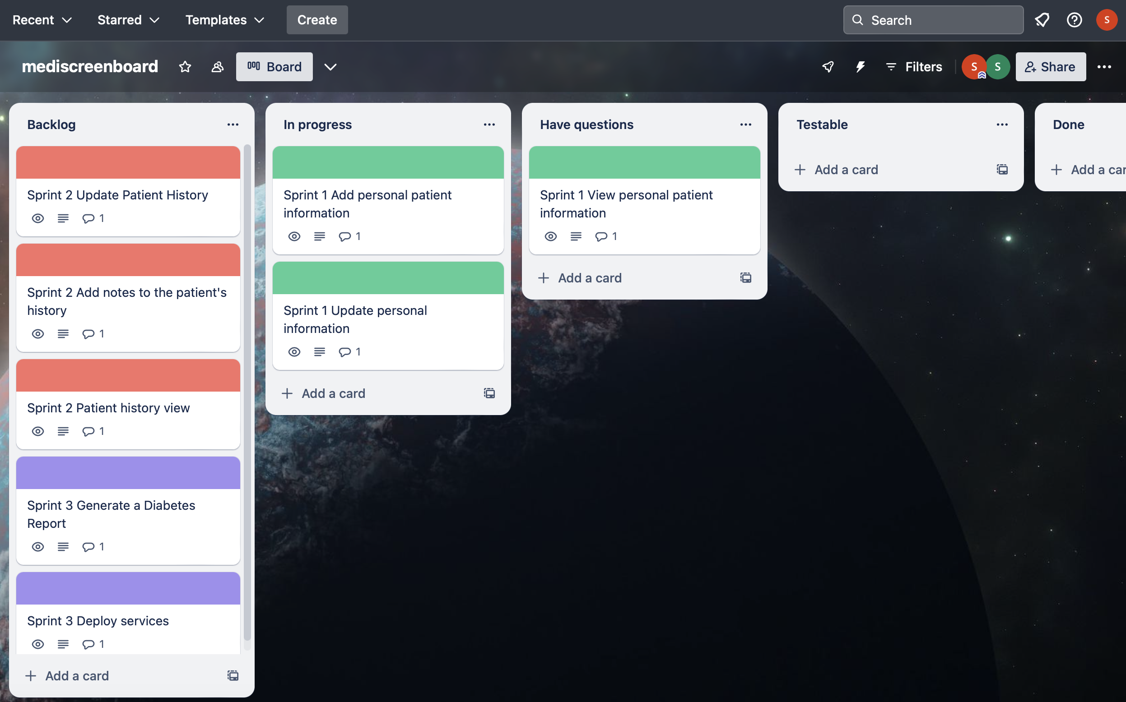
Trello

Slide 9
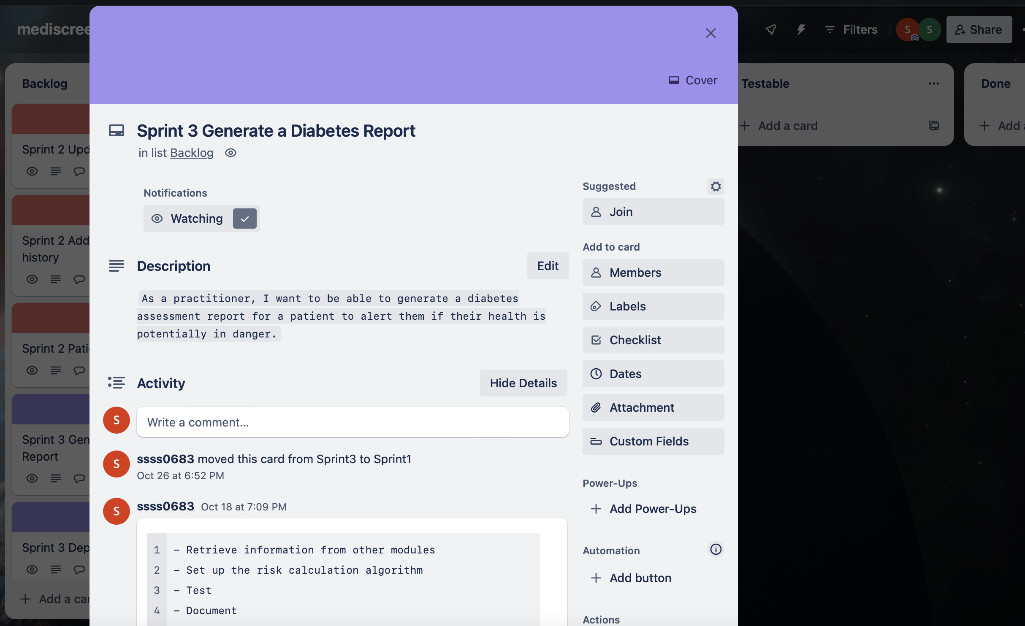
Trello

Slide 10
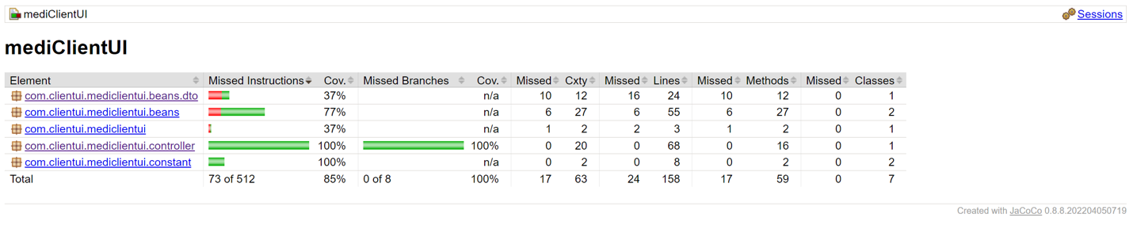
Test Coverage

Slide 11
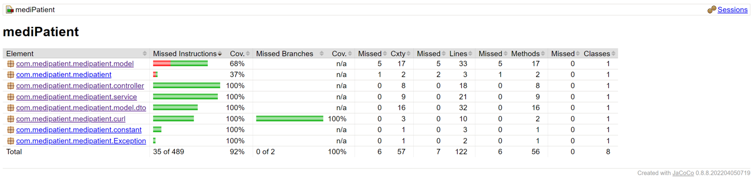
Test Coverage

Slide 12
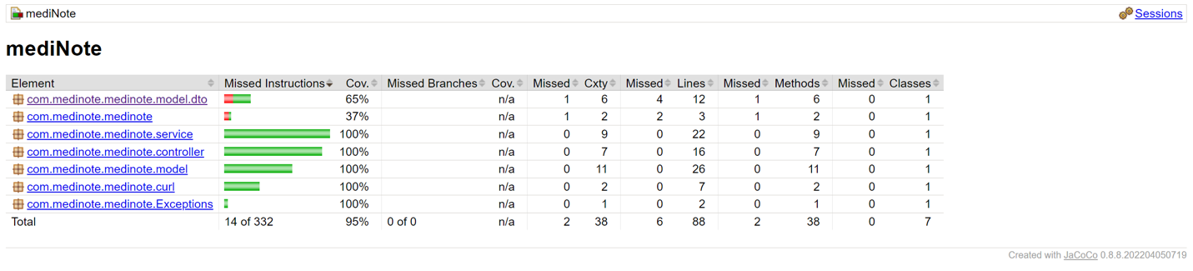
Test Coverage

Slide 13
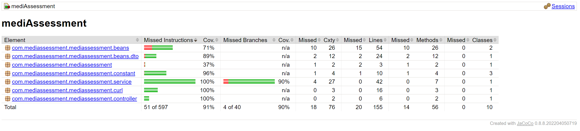
Test Coverage

Slide 14
Difficulties/solution
No SQL
How to set up a NoSQL database for notes?
Solution - Using MongoDB with the MongoRepository.

Slide 15
Thank you for your attention !

